Slide 1
Visualization of Analytical Data

Slide 2
Fraud Claim Track

Slide 3
Data visualization plays a vital role in life of a Data Scientist.

Slide 4
It is easier to visualize complex data and relationships than
deciphering them from spreadsheets / tables.

Slide 5
There are several tools for visualizing data such as Tableau, Qlik, Dygraphs, Kibana etc.

Slide 6
Today I am going to walk through Shiny for Data Visualization.

Slide 7
Shiny is an open source R package that provides an elegant and powerful web framework for building web applications using R.

Slide 8
Shiny helps us turn our analysis into interactive web applications without
requiring much HTML, CSS, or JavaScript knowledge.

Slide 9
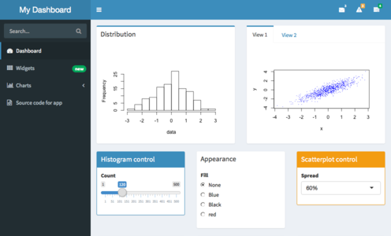

Slide 10
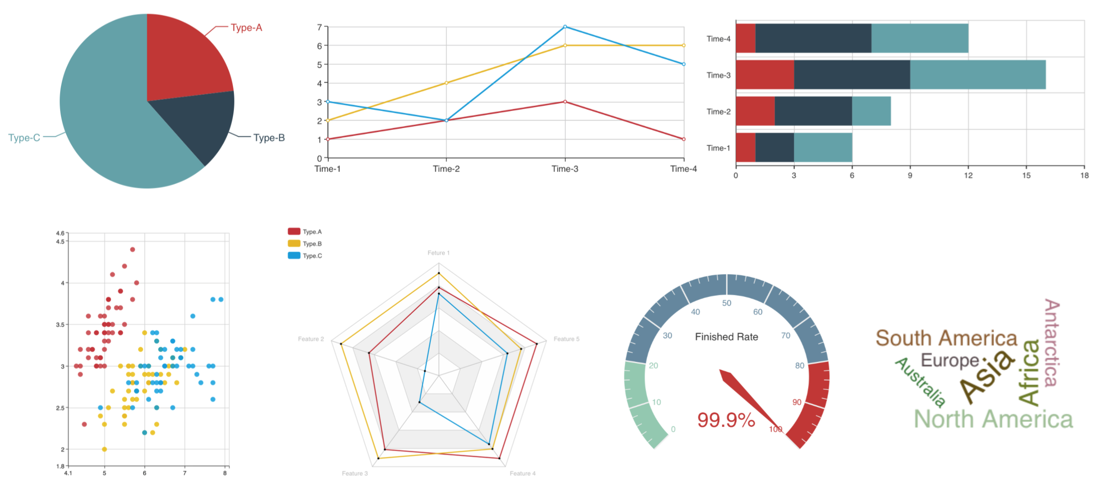

Slide 11
Visualizing Streaming Data with Shiny

Slide 12
Streaming Data is data that is generated continuously and it includes various sources such as sensors, log files, geospatial services, etc. The data may come at regular intervals and we may want to have a dashboard which updates by itself and incorporates the newly added data so that we can use it for data driven decision making. For example in IOT, it can help to monitor sensors which are failing or sensors which report abnormal readings.

